Slide 1
EXPEDIA Hotel Recommendation Based on historical Data
Summer Wang
Yawen Ye
Matt Staton
Wenduo Wang

Slide 2
Table of Contents
Data and motivation
A peek into the data
Feature engineering
Random Forest
A simpler approach
Concluding remarks

Slide 3
Data and Motivation
“Currently, Expedia uses search parameters to adjust their hotel recommendations, but there aren't enough customer specific data to personalize them for each user. In this competition, Expedia is challenging Kagglers to contextualize customer data and predict the likelihood a user will stay at 100 different hotel groups.”
---Expedia Inc.

Slide 4
Data and Motivation
In million $ | 2014 | 2013
Data center and other costs | 229 | 199
% Revenue | 3.98 | 4.17
% Net income | 61.4 | 91.9
Data is eating profit.

Slide 5
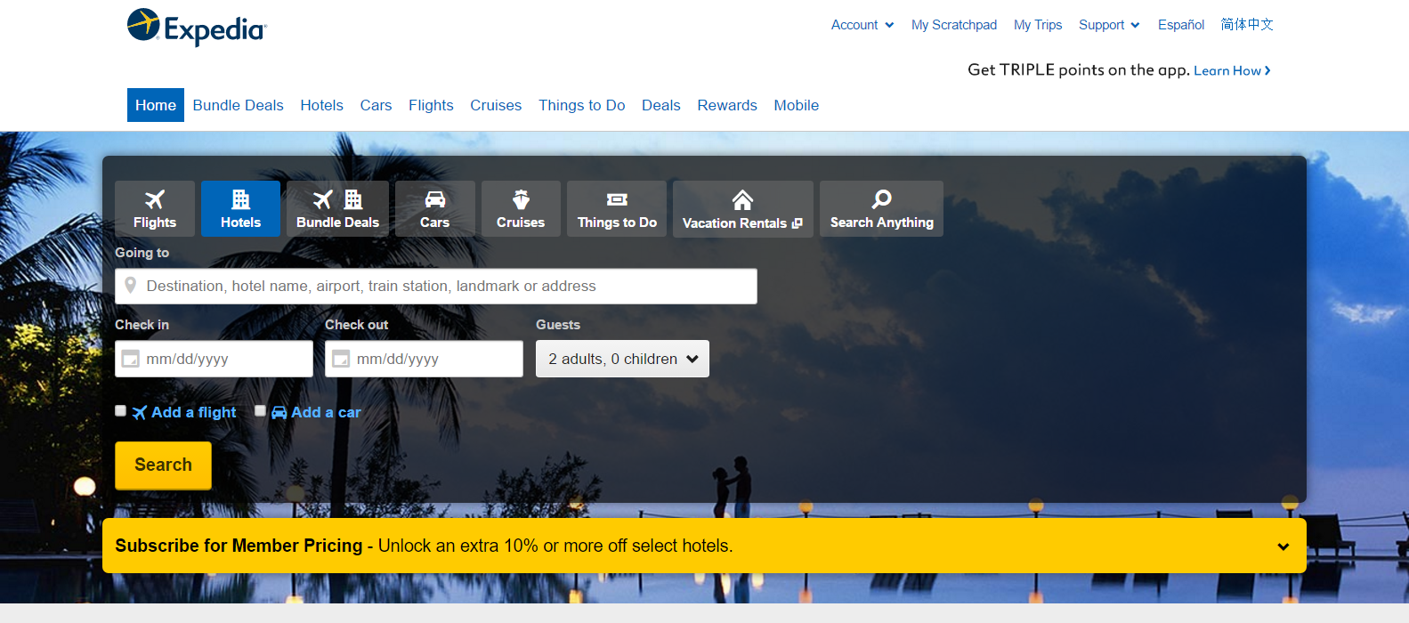
Data and Motivation

Slide 6
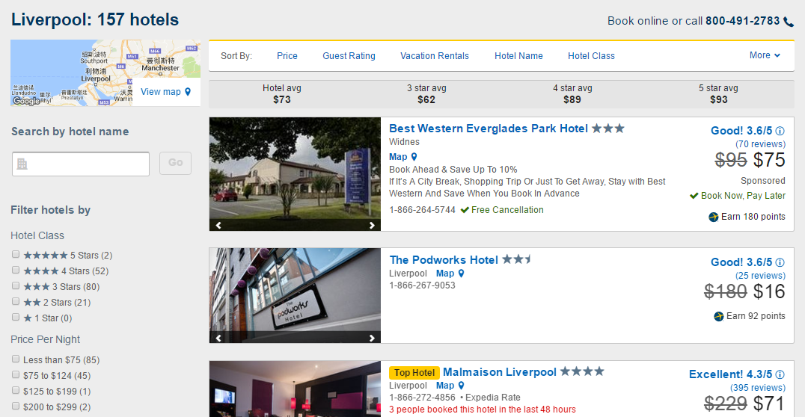
Data and Motivation

Slide 7
Data and motivation
Train.csv
Randomly selected user searching history in 2013 and 2014
Test.csv
Matching users’ searching history in 2015
Destinations.csv
149 attributes for each destination

Slide 8
Data and Motivation
The goal
Train
In 2013/14, xxx users saw yyy recommendations, and booked zzz
Test
In 2015, xxx users came back, which hotels to recommend to them that they are most likely to book?

Slide 9
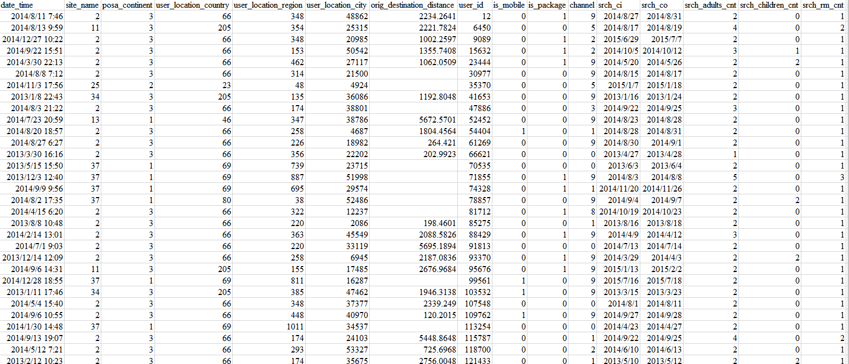
A peek into the data
37M rows * 24 cols = 4GB

Slide 10
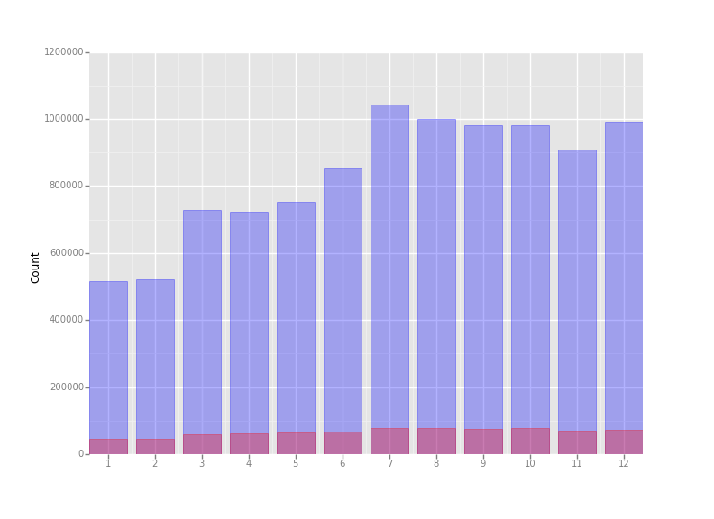
A peek into the data
Searches and bookings by month
Clear seasonal pattern
Summer vacation hump
Christmas/New Year holidays hump
Average order conversion rate 8%

Slide 11
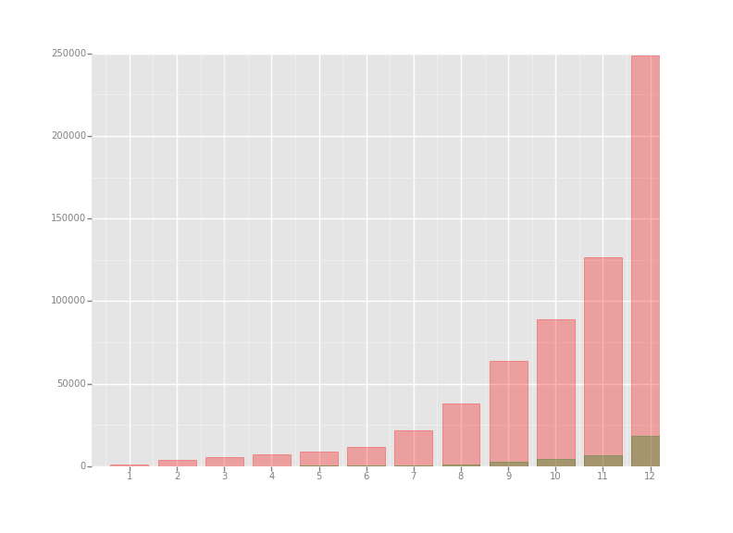
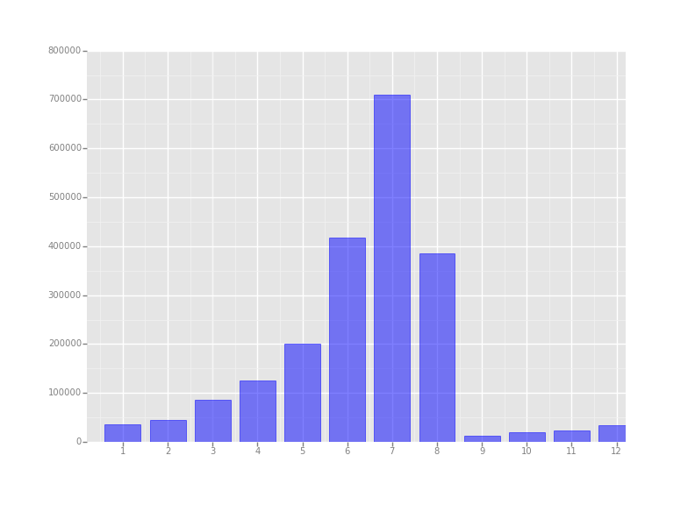
A peek into the data
When do people search for Christmas hotel
When do people search for summer hotel

Slide 12
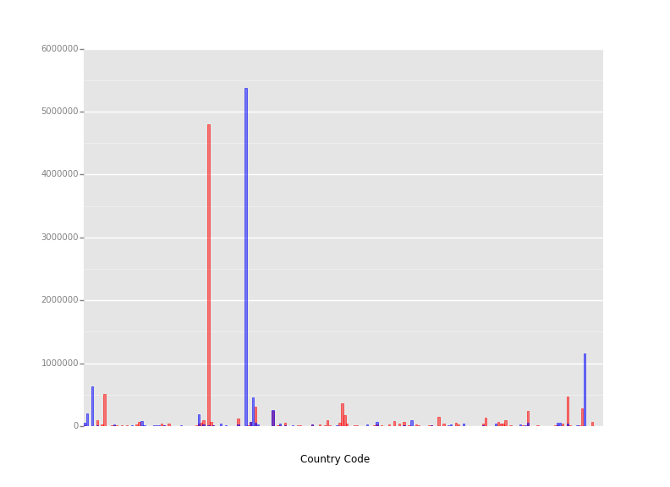
A peek into the data
Hot countries (Blue = user country, Red = hotel country)
Each country has 2 codes
Clear pairwise pattern
Mostly domestic traveling

Slide 13
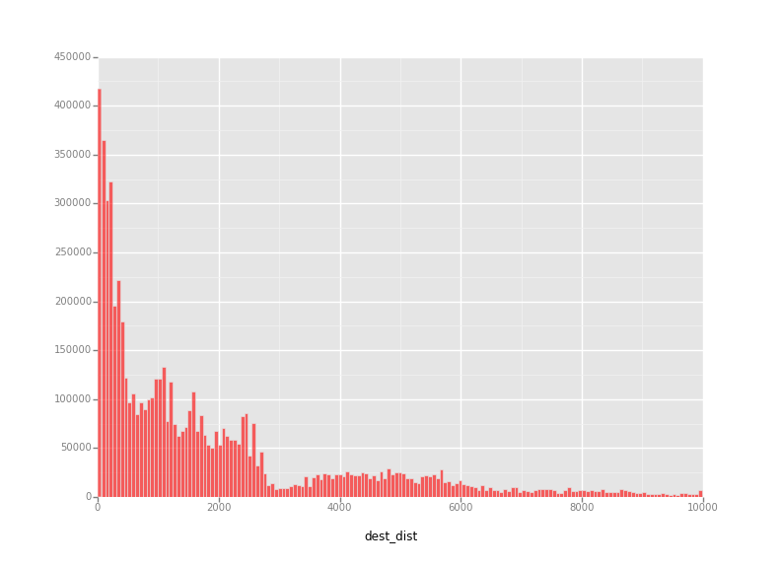
A peek into the data
Hotel distance
Most hotels are not far away
Essentially a cross-sectional map
Mostly domestic traveling

Slide 14
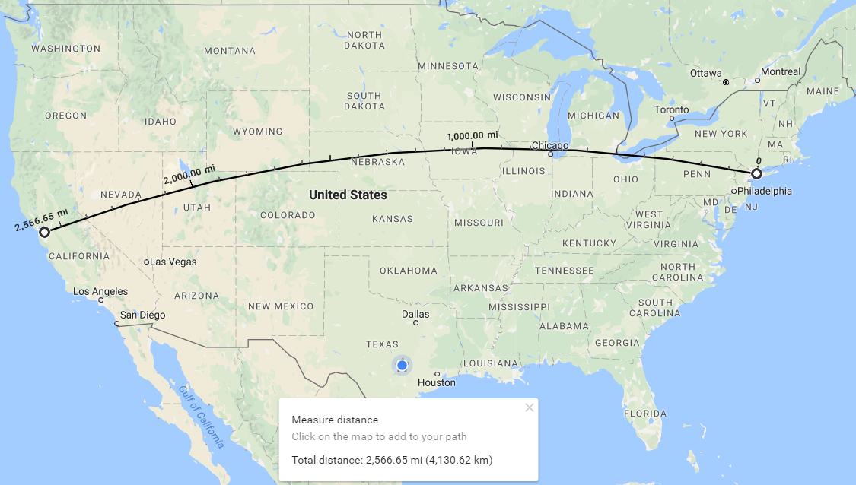
A peek into the data

Slide 15
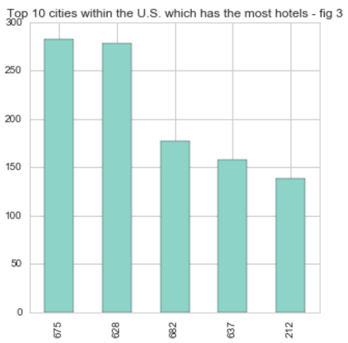
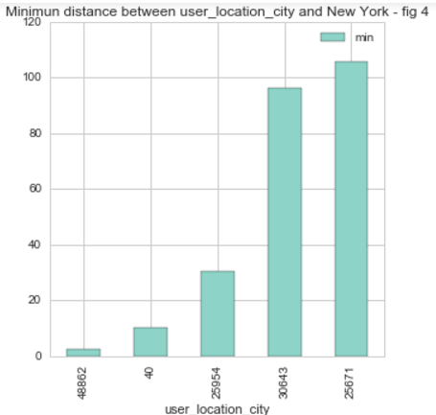
A peek into the data
hotel_city | Minimum distance from New York to each hotel_city | City Name | The distace between New York and other cities from Google
696 | 83.6768 | Philadelphia | 80.63
690 | 191.5407 | Boston | 190.42
191 | 206.8054 | Washington | 203.78
641 | 481.6371 | Detroit | 481.10
637 | 712.4291 | Chicago | 711.83
701 | 1091.2484 | Miami | 1093.57
628 | 2233.3839 | Las Vegas | 2230.03

Slide 16
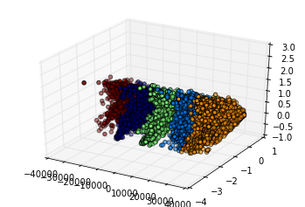
Feature engineering
Destinations
Time data
NaN and scaling
In training set there are over 60 thousand destinations
Each destination contain 149 attributes
Apply PCA to reduce destination from 60 thousand to 149 dimension
149 is still large. Take the top 3 dimensions.
Native date parser in read_csv() sometimes fails
Explicitly coerce the data into datetime format using to_datetime() method
Missing values account for a small portion in the dataset, and are not dropped or imputed.
Scaling is not performed since continuous variables

Slide 17
Random forest
Data slicing
Model
Prediction error
The whole training set is unwieldy even on a server, and therefore we randomly selected records of 10000 users to restrict memory usage.
from sklearn.ensemble import RandomForestClassifier
All variables are dropped into the model
Slow training process due to data volume.
from sklearn import cross_validation
3-fold cv average score: 0.06 – something must be wrong!

Slide 18
A simpler approach
Even RF is struggling – let’s get a new car.
Probably it’s because of the fuzzy-blurry data?
Hmm, why not also dispose the slow training process and make it faster?

Slide 19
A simpler approach
www.expedia.com
… …
Destination_2: {
Hotel_6: 40,
Hotel_2: 30,
Hotel_3: 25,
…
}
Destination_3:{
Where are you going?
Destination_2:{
Destination_1: {
Hotel_1: score,
Hotel_2: score,
Hotel_3: score,
…
}
Historical Data
Score = Σ (#booking + 0.15×#clicking)

Slide 20
A simpler approach
CV accuracy = 23% (not that good? Remember RF was 6%!)
Very few variables are required, data volume significantly reduced
Faster, faster, faster! (15mins vs eyeblink)
When new data becomes available, only update the “score book”, no more training is needed – highly scalable
Yeah… but it is not customized for each user

Slide 21
Concluding remarks
Customization is conceptually good, but not always comes practically easy.
Simpler solution sometimes outperforms complex models in a large scale.
In our case, by simply recommending the most popular hotels in a place, the system is better off than considering every letter from the user’s keyboard.
“Currently, Expedia uses search parameters to adjust their hotel recommendations, but there aren't enough customer specific data to personalize them for each user. In this competition, Expedia is challenging Kagglers to contextualize customer data and predict the likelihood a user will stay at 100 different hotel groups.”
Good idea, but really necessary?

Slide 22

Of all the gin joints, in all the towns, in all the world, she walks into mine…

Slide 23

Probably she had a quick look on Yelp.

Slide 24
Thanks

